Slide 1
A Sunday morning in Paris
Author: F. Muller - Coursera Capstone project

Slide 2
Business problem
Paris contains hundreds of museums, and they are fantastic tourist attractions.
Organizing and offering interesting visits is a continued challenge for tourist agencies.
Problem: museums make people hungry!
→ Offering museum + restaurant combinations is a business opportunity for tourist agencies.

Slide 3
Data: how to exploit it to solve our business problem?
In order to offer interesting packages, the museums must be sorted into relevant classes → This is the process of clustering using machine learning
Using the Foursquare API allows to gather venue data for each museum → This data contains the category of each restaurant, which can be used in the clustering.
Geo-localization data for each museum Paris is available on Wikipedia.

Slide 4
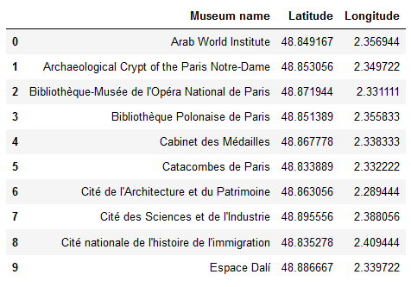
Methodology: web scraping
Wikipedia page “List of museums in Paris” (English version)
Museum names
Link
Museum latitude + longitude
Wikipedia page of each museum (French version)

Slide 5
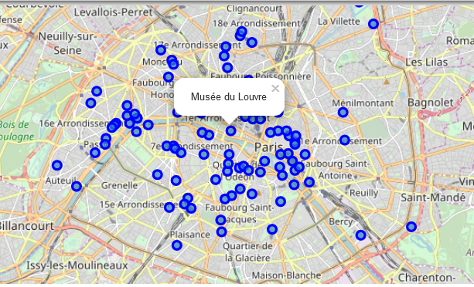
Result of the web scraping
Folium map showing the position of all museums in Paris

Slide 6
Methodology: usage of the Foursquare API
Museum
Chinese Restaurant
French Restaurant
Italian Restaurant
French Restaurant
Bistro
Bakery
Credentials
Foursquare API
Museum coordinates

Slide 7
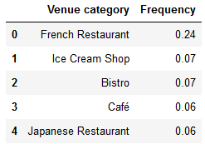
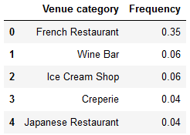
Methodology: data cleaning
Example venue frequencies:
Arab World Institute
Issues:
some museums with very venues → removed from the study
some venue categories with only a few venues, or very similar with each other → categories fused together
the “French Restaurant” category is dominant → ensure that the presence of other venue categories is taken into account in the clustering
Polish Library in Paris

Slide 8
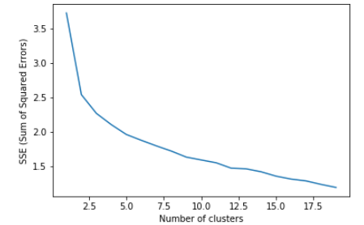
Methodology: k-means clustering
Usage of the k-means clustering algorithm
To determine the “best” number of clusters, the “elbow method” is used by calculating the Sum Of Squared Errors for k between 2 and 20.
The “elbow” is located around k = 3, and we pick k = 4 from personal experience with the clusters returned.

Slide 9
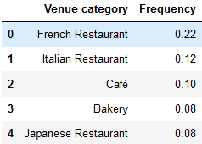
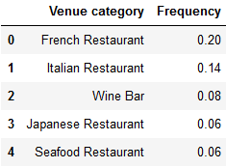
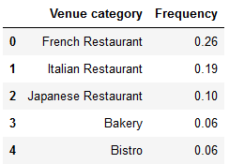
Results: identification of the 4 clusters
Gobelins manufactory
Mundolingua
Cernuschi museum
Examples from cluster no 1:
The first cluster contains French Restaurants around 25%, and a lot of Italian (10-20%) and Japanese (around 10%) restaurants.
“French/Italian/Japanese”

Slide 10
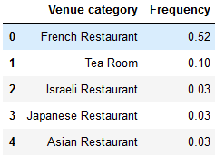
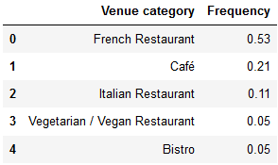
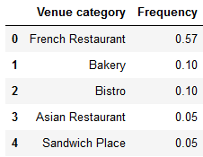
Results: identification of the 4 clusters
Galerie nationale
du Jeu de Paume
Rodin museum
Orsay museum
Examples from cluster no 2:
The second cluster contains mostly French Restaurants (around 50%), and a lot of Cafés and Bistros.
“Traditional French”

Slide 11
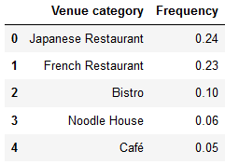
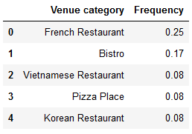
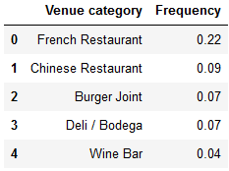
Results: identification of the 4 clusters
Museum of Jewish
Art and History
Cabinet des Médailles
Pasteur museum
Examples from cluster no 3:
The third cluster is much more diverse than the others, with more restaurants from Asia or the rest of the World. For some rare museums, other categories than “French Restaurant” are the most frequent.
“Cosmopolitan”

Slide 12
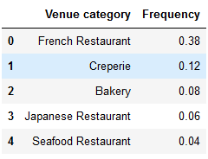
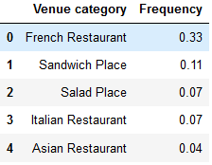
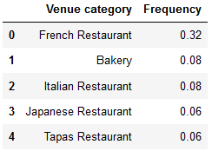
Results: identification of the 4 clusters
Archaeological Crypt of the Paris Notre-Dame
Bibliothèque-Musée de l'Opéra National de Paris
Maison de Victor Hugo
Examples from cluster no 4:
The fourth cluster contains around 30% of French Restaurants, and Bakeries are coming up more often than in other clusters.
“Baguette zone”

Slide 13
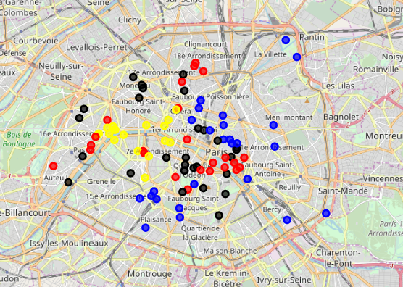
Results: display of the clusters on a map
When coloring the previous map by clusters, we obtain this map.
Yellow: “Traditional French”
Red: “Baguette zone”
Blue: “Cosmopolitan”
Black: “French/Italian/Japanese”

Slide 14
Discussion: display of the clusters on a map
Coherence with the Paris neighborhoods:
“Traditional French” around the Eiffel tower and Louvre landmarks
“Cosmopolitan” in the Marais and in the periphery
“Baguette zone” in the popular Pigalle and Quartier Latin neighborhoods
“French/Italian/Japanese” in the upper-class St-Germain neighborhood
Pigalle
Louvre
Marais
Eiffel tower
Quartier Latin
Yellow: “Traditional French”
Red: “Baguette zone”
Blue: “Cosmopolitan”
Black: “French/Italian/Japanese”
St-Germain

Slide 15
Conclusion: business ideas
A possible business plan for a travel agency wanting to offer coherent museum + restaurant combinations could be:
A “Premium” offer for the traditional area of the cluster “Traditional French”.
A “Business” offer for the upper-class area of the cluster “French/Italian/Japanese”.
A “Economy” offer (maybe aimed at students) for the cluster “Baguette zone”.
A “World” offer aimed at multi-cultural tourists for the cluster “Cosmopolitan”.
Possible continuations for this study by taking into account:
the type of each museum in the classification
the rating of each venue in the Foursquare API
the distance between museums in each cluster in order to offer multiple-museum visits.

